Slide 1

(End-to-End Methods for) Dialogue, Interaction and Learning
Jason Weston
Facebook AI Research
Collaborators: D. Batra, A. Bordes, Y. Boureau, S. Chopra, J. Dodge, W. Feng, R. Fergus, A. Fisch, A. Gane, M. Henaff, F. Hill, A. Joulin, Y. LeCun, J. Lu, B. van Merriënboer, J. Li, T. Mikolov, A. H. Miller, D. Parikh,
A.M. Rush, S. Sukhbaatar, A. Szlam, X. Zhang

Slide 2
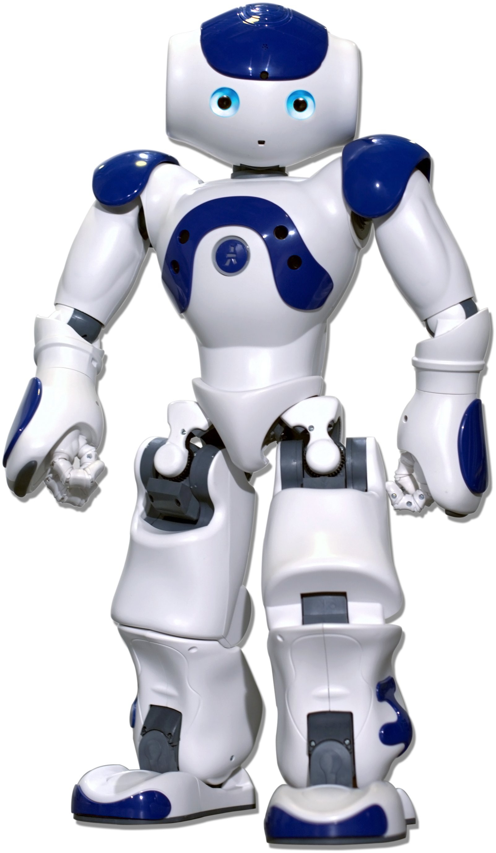
Language Grounded Robots need to:
be able to track the world state & reason (people, objects, things)

Slide 3
Language Grounded Robots need to:
be able to track the world state & reason (people, objects, things)
learn from language feedback (i.e. the things said to it)

Slide 4
Language Grounded Robots need to:
be able to track the world state & reason (people, objects, things)
learn from language feedback (i.e. the things said to it)
learn from asking questions (which questions? when to ask?)

Slide 5
Language Grounded Robots need to:
be able to track the world state & reason (people, objects, things)
learn from language feedback (i.e. the things said to it)
learn from asking questions (which questions? when to ask?)
be bootstrapped from training data! (diverse & lots of it?)
have a unified learning system not a bunch of hard-coded hacks

Slide 6
Language Grounded Robots need to:
be able to track the world state & reason (people, objects, things)
Tracking the World State with Recurrent Entity Networks. Henaff et al., ICLR ’17
learn from language feedback (i.e. the things said to it)
Dialogue Learning With Human-in-the-Loop. Li et al., ICLR ‘17.
learn from asking questions (which questions? when to ask?)
Learning through Dialogue Interactions by Asking Questions. Li et al., ICLR ‘17.
be bootstrapped from training data! (diverse & lots of it?)
have a unified learning system not a bunch of hard-coded hacks
ParlAI: A Dialog Research Software Platform. Miller et al., EMNLP ‘17.

Slide 7
Language Grounded Robots need to:
be able to track the world state (people, objects, things)
Tracking the World State with Recurrent Entity Networks. Henaff et al., ICLR ’17
learn from language feedback (i.e. the things said to it)
Dialogue Learning With Human-in-the-Loop. Li et al., ICLR ‘17.
learn from asking questions (which questions? when to ask?)
Learning through Dialogue Interactions by Asking Questions. Li et al., ICLR ‘17.
be bootstrapped from training data! (diverse & lots of it?)
have a unified learning system not a bunch of hard-coded hacks
ParlAI: A Dialog Research Software Platform. Miller et al., EMNLP ‘17.

Slide 8
Reasoning, Attention & Memory Models
Memory Network
Addressing:
score m_{i} w.r.t. q
Read:
return best m_{i}
[Figure by Saina Sukhbaatar]

Slide 9
Memory-Augmented Networks
Some related models:
RNN-Search (Bahdanau et al.’14), NTM (Graves et al, ‘14), Stack RNNs (Joulin & Mikolov, ’15, Grefenstette et al, ‘15), Dynamic Mem. Nets (Kumar et al., ‘15), DNC (Graves et al., ’16), MemN2N (Sukhbaatar et al.)…
Memory Network
Addressing:
score m_{i} w.r.t. q
Read:
return best m_{i}
[Figure by Saina Sukhbaatar]

Slide 10
Memory-Augmented Networks
Some related models:
RNN-Search (Bahdanau et al.’14), NTM (Graves et al, ‘14), Stack RNNs (Joulin & Mikolov, ’15, Grefenstette et al, ‘15), Dynamic Mem. Nets (Kumar et al., ‘15), DNC (Graves et al., ’16), MemN2N (Sukhbaatar et al.)…
1st Sep
2014
15th Oct 2014
20th Oct 2014
Memory Network
Addressing:
score m_{i} w.r.t. q
Read:
return best m_{i}
[Figure by Saina Sukhbaatar]
Class of models has been shown to work on a wide variety of NLP tasks:
QA datasets (SQuAD, bAbI, QACNN, QADaily Mail, CBT, …)
Dialog (Ubuntu, Twitter, Reddit, …)
Visual QA and Visual Dialog (VQA, VQA-v2, Visdial)
Machine Translation, …

Slide 11
Recurrent Entity Network (Henaff et al., ICLR ‘17)
Track things (e.g. Bob, John, football) by learning to store in memory and updating
Doesn’t assume memories m_{i} are given.
Learns how to read & write to memory.
Bob picked up the football.
John went to the office.
Bob went to the kitchen.
Where is the football?
RNN₁
Key₁ Value₁
Key₁ Value₁
Key₁ Value₁
RNN₂
Key₂ Value₂
Key₂ Value₂
Key₂ Value₂
Key₃ Value₃
Key₃ Value₃
Key₃ Value₃
RNN₃
Key₄ Value₄
Key₄ Value₄
Key₄ Value₄
RNN₄
time t-3 t-2 t-1
Question)

Slide 12
Recurrent Entity Network (Henaff et al., ICLR ‘17)
Encoder Module: encodes each input to a fixed size vector.
Memory Module: consists of key, value pairs that are learnt.
Each memory slot is an RNN (with shared weights).
Every RNN is fed the next input.
Updated via gating function dependent on key and value.
Output Module: given a question, uses only a 1-hop memory network This works as it maintains the “state of the world” in memory.
.
Bob went to the kitchen.
Where is the football?
RNN₁
Key₁ Value₁
Key₁ Value₁
Key₁ Value₁
RNN₂
Key₂ Value₂
Key₂ Value₂
Key₂ Value₂
Key₃ Value₃
Key₃ Value₃
Key₃ Value₃
RNN₃
Key₄ Value₄
Key₄ Value₄
Key₄ Value₄
RNN₄
time t-2 t-1 t
Question)

Slide 13
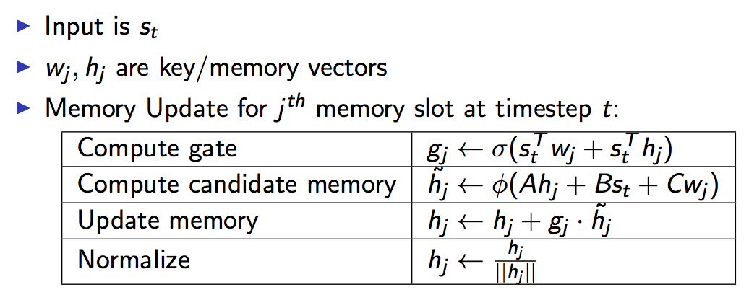
Recurrent Entity Network (Henaff et al., ‘16)
.
Bob went to the kitchen.
Where is the football?
RNN₁
Key₁ Value₁
Key₁ Value₁
Key₁ Value₁
RNN₂
Key₂ Value₂
Key₂ Value₂
Key₂ Value₂
Key₃ Value₃
Key₃ Value₃
Key₃ Value₃
RNN₃
Key₄ Value₄
Key₄ Value₄
Key₄ Value₄
RNN₄
This model can reason while it is storing memories, MemNNs cannot.
Goal: Maintain an approximate “state of the world” in memory
time t-2 t-1 t
Question)

Slide 14
Robot Navigation Example
Two agents moving in a 10x10 grid.
Model has to predict their (x,y) locations given T updates about their movements.
Solution: track the agents in memory, ~~~~~~~~update as you go (EntNet)
Task Learner Sees:
Agent1 is at (2,8)
Agent1 faces North
Agent2 is at (9,7)
Agent2 faces North
Agent2 moves forward 2
Agent2 faces East
Agent2 moves forward 1
Agent1 moves forward 2
Agent2 faces South
Agent2 moves forward 5
Where is Agent1?
Where is Agent2?
A: (2,10)
A: (10,4)
 | T=10 | T=20 | T=40
MemN2N | 0.09 | 0.633 | 0.896
LSTM | 0 | 0.157 | 0.2226
EntNet (1 hop) | 0 | 0 | 0
Training for T=20, Test on T’ | T’=40 | T’=60 | T’=80
EntNet | 0 | 0.03 | 0.08

Slide 15
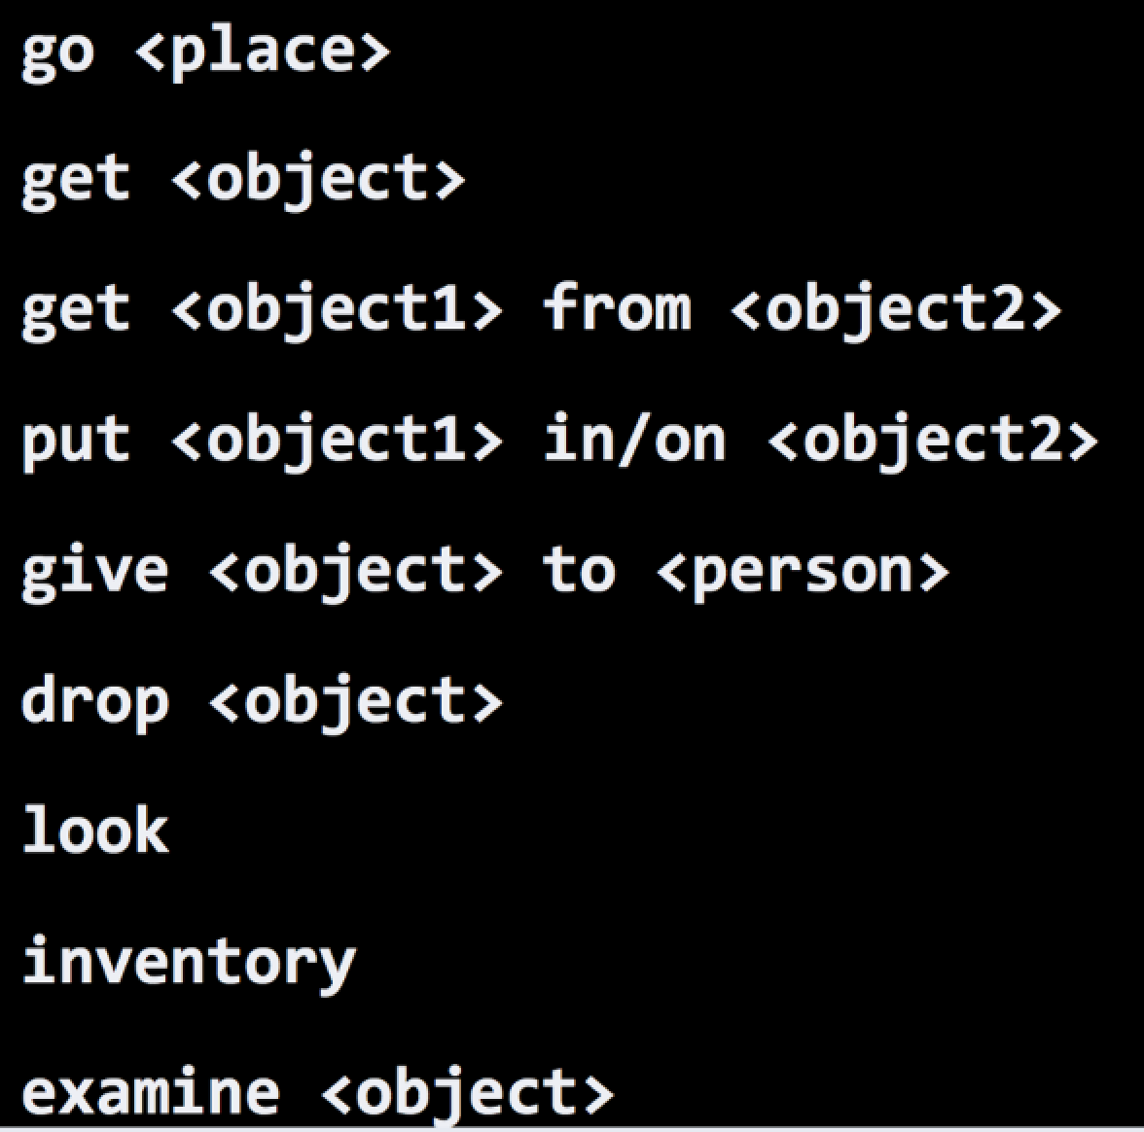
bAbI: simple grounded simulator

Slide 16
bAbI Tasks (Weston et al., ‘15)
Set of 20 tasks testing basic reasoning capabilities from simulated stories
Useful to foster innovation: cited 255+ times, used to evaluate new methods
Attention during mem lookup
20 bAbI Tasks
1k training set
 | Test Acc | Failed tasks
LSTM | 49% | 20
MemN2N 1 hop | 74.8% | 17
2 hops | 84.4% | 11
3 hops | 87.6.% | 11

Slide 17
bAbI - 10k training examples
10k training set
 | Test Acc | Failed tasks
LSTM | 36.4% | 16
D-NTM | 12.8% | 9
MemN2N (3 hops) | 4.2% | 3
DNC | 3.8% | 2
Dynamic MemNet | 2.8% | 1
EntNet (1 hop) | 0.5% | 0
QRN (Seo et al) | 0.3% | 0

Slide 18
bAbI 1k and 10k comparisons
Important!! Data efficiency / task transfer
1k training set 10k training set
 | Test Acc | Failed tasks
LSTM | 51% | 20
NTM | ??? | ???
MemN2N (3 hops) | 12.4.% | 11
DNC | ??? | ???
Dynamic MemNet | 24.9% | 12
EntNet (1 hop) | 29.6% | 15
QRN | 11.3% | 5
 | Test Acc | Failed tasks
LSTM | 36.4% | 16
D-NTM | 12.8% | 9
MemN2N (3 hops) | 4.2% | 3
DNC | 3.8% | 2
Dynamic MemNet | 2.8% | 1
EntNet (1 hop) | 0.5% | 0
QRN (Seo et al) | 0.3% | 0

Slide 19
How about on real data?
Toy AI tasks are important for developing innovative methods.
But they do not give all the answers.

Slide 20
QA on REAL children’s stories
Predict missing word in a sentence given 20 previous sentences as multiple choice task.

Slide 21
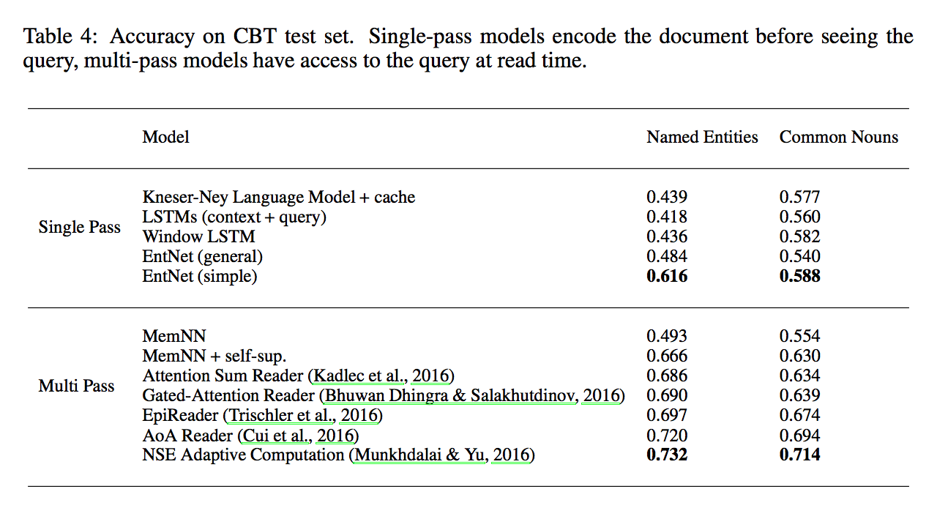
Results on Children’s Book Test

Slide 22
Language Grounded Robots need to:
be able to track the world state (people, objects, things)
Tracking the World State with Recurrent Entity Networks. Henaff et al., ICLR ’17
learn from language feedback (i.e. the things said to it)
Dialogue Learning With Human-in-the-Loop. Li et al., ICLR ‘17.
learn from asking questions (which questions? when to ask?)
Learning through Dialogue Interactions by Asking Questions. Li et al., ICLR ‘17.
be bootstrapped from training data! (diverse & lots of it?)
have a unified learning system not a bunch of hard-coded hacks
ParlAI: A Dialog Research Software Platform. Miller et al., EMNLP ‘17.

Slide 23
Learning From Human Responses
Mary went to the hallway.
John moved to the bathroom.
Mary travelled to the kitchen.
Where is Mary? A:playground
No, that's incorrect.
Where is John? A:bathroom
Yes, that's right!
If you can predict this, you are most of the way to knowing how to answer correctly.

Slide 24
Human Responses Give Lots of Info
Mary went to the hallway.
John moved to the bathroom.
Mary travelled to the kitchen.
Where is Mary? A:playground
No, the answer is kitchen.
Where is John? A:bathroom
Yes, that's right!
Much more signal than just “No” or zero reward.
Related to Sanja Fidler‘s talk!!!!!

Slide 25
Forward Prediction Memory Network (Weston, ‘16)
new state of world
“Unsupervised” Forward Model: does not require labeled supervision

Slide 26
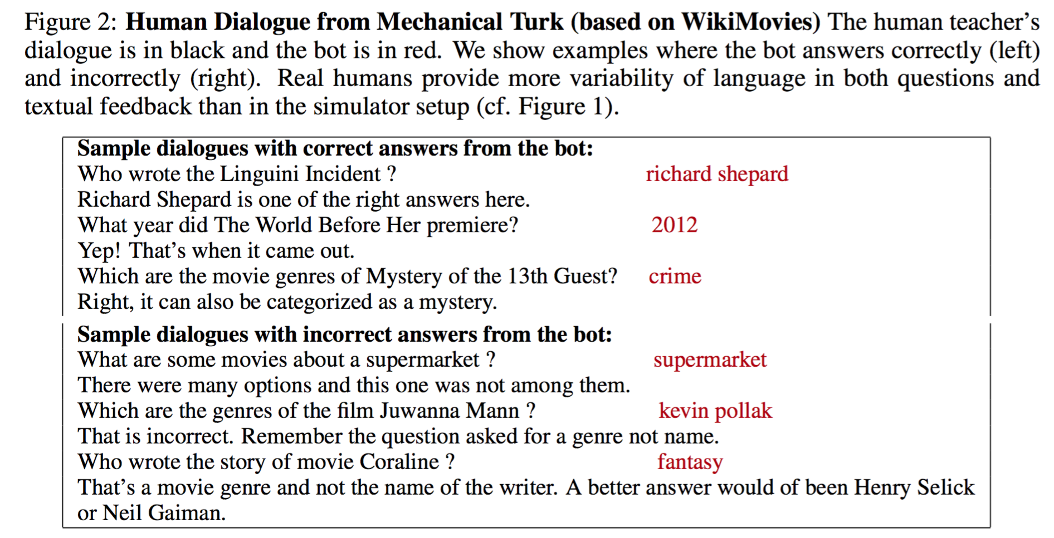
Real Human Questions+Feedback
Much more diversity!!

Slide 27
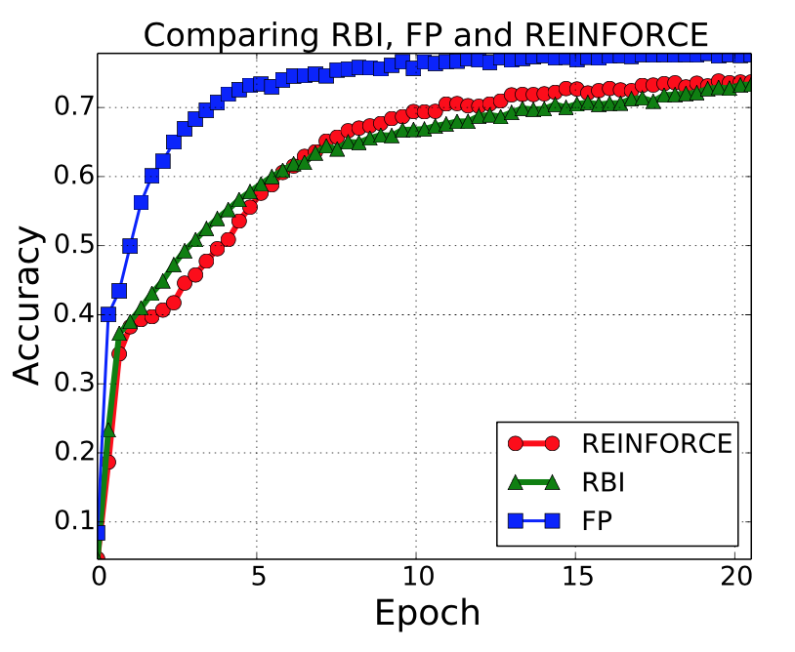
Dialog Feedback: Results
WikiMovies
Forward Prediction MemNN (FP) which uses textual rewards
can perform better than using numerical rewards (RBI or REINFORCE)!!

Slide 28
Language Grounded Robots need to:
be able to track the world state (people, objects, things)
Tracking the World State with Recurrent Entity Networks. Henaff et al., ICLR ’17
learn from language feedback (i.e. the things said to it)
Dialogue Learning With Human-in-the-Loop. Li et al., ICLR ‘17.
learn from asking questions (which questions? when to ask?)
Learning through Dialogue Interactions by Asking Questions. Li et al., ICLR ‘17.
be bootstrapped from training data! (diverse & lots of it?)
have a unified learning system not a bunch of hard-coded hacks
ParlAI: A Dialog Research Software Platform. Miller et al., EMNLP ‘17.

Slide 29

A bot can improve by asking questions
How do you like Hom Tanks?

Slide 30

A bot can improve by asking questions
Case 1
How do you like Hom Tanks?
Who is Hom Tanks ?

Slide 31
A bot can improve by asking questions
Case 1
How do you like Hom Tanks?
Who is Hom Tanks ?
Do you mean Tom Hanks ?

Slide 32
A bot can improve by asking questions
Case 1
How do you like Hom Tanks?
Who is Hom Tanks?
Hom Tanks is the leading actor in Forest Gump.

Slide 33
A bot can improve by asking questions
Case 1
How do you like Hom Tanks?
Who is Hom Tanks?
Hom Tanks is the leading actor in Forest Gump.
Oh. Yeah. I like him a lot.

Slide 34
A bot can improve by asking questions
Case 1
How do you like Tom Hardy?
Who is Tom Hardy?
Tom Hardy is Max in Mad Max: Fury Road
Oh. Yeah. I like him a lot.

Slide 35
A bot can improve by asking questions
What will Current Chatbot Systems Do ?
How do you like Hom Tanks?

Slide 36
A bot can improve by asking questions
What will Current Chatbot Systems Do ?
How do you like Hom Tanks?
How do you like Hom Tanks?
UNK

Slide 37
A bot can improve by asking questions
What will Current Chatbot Systems Do ?
How do you like Hom Tanks?
How do you like UNK ?

Slide 38
A bot can improve by asking questions
What will Current Chatbot Systems Do ?
How do you like Hom Tanks?
How do you like UNK ?
Give an output anyway

Slide 39
A bot can improve by asking questions
What will Current Chatbot Systems Do ?
How do you like Hom Tanks?
How do you like UNK ?
Forward Backward
softmax

Slide 40
A bot can improve by asking questions
What will Current Chatbot Systems Do ?
How do you like Hom Tanks?
How do you like UNK ?
output
I hate him. He’s such a jerk.
Forward Backward
softmax

Slide 41

A bot can improve by asking questions
What will Current Chatbot Systems Do ?
How do you like Hom Tanks?
Searching the Web for “how do you like Hom Tanks”

Slide 42
We constructed new datasets based on MovieQA that identify 3 kinds of bot questions:
Teacher question: “What is Tom Hanks in?”
1. Text Clarification - query how to interpret text of teacher
e.g. What do you mean? / Do you mean which movie did Tom Hanks star in?
2. Knowledge Operation - query how to perform reasoning steps necessary to answer
e.g. Does it have something to do with Tom Hanks starring in Forrest Gump?
3. Knowledge Acquisition: query to gain missing knowledge necessary to answer
e.g. I don’t know, what did he star in?
We construct datasets with episodes of dialog:
the bot can ask question (AQ) at first
we evaluate the bot on QA at the end of the episode
datasets available at http://fb.ai/babi

Slide 43
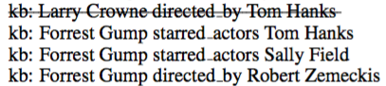

Training
Input
… Other questions/ Other answers

Slide 44
Training
Input
… Other questions/ Other answers
The teacher’s question

Slide 45
Training
Input
… Other questions/ Other answers
Dialogue History

Slide 46
Training
Input
… Other questions/ Other answers
KB facts

Slide 47
Training
Input
… Other questions/ Other answers
Output

Slide 48
Training
Input
… Other questions/ Other answers
End-to-End Memory Networks
Output

Slide 49

Test
Input
… Other questions/ Other answers
Output
?????

Slide 50
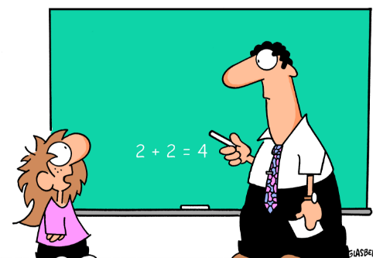
Reinforcement Learning Setting
We consider an existing (pre-trained):
Good, medium and poor student
And then allow them to ask questions.
There is a cost to asking.
There is a reward for getting exam questions right.
Shall I ask a question ???

Slide 51
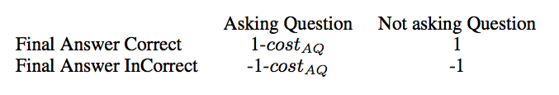
Which movvie did Tom Hanks sttar in?
AQ
QA
What do you mean?
Forrest Gump.
I mean which film did Tom Hanks appear in.
That’s correct (+)
Forrest Gump.
Reward: +1
That’s correct (+)
Reward: 1-CostAQ

Slide 52
Summary of results:
Question asking gives better bots at question answering than not asking!

Slide 53
Summary of results:
Increased question asking cost decreases the chance of the student asking.
A good student does not need to ask anyway.

Slide 54
Summary of results:
As the probability of question-asking declines, the accuracy for poor and medium students drops.

Slide 55
Summary of results:
As the AQ cost increases gradually, good students will stop asking questions earlier than the medium and poor students.

Slide 56
Language Grounded Robots need to:
be able to track the world state (people, objects, things)
Tracking the World State with Recurrent Entity Networks. Henaff et al., ICLR ’17
learn from language feedback (i.e. the things said to it)
Dialogue Learning With Human-in-the-Loop. Li et al., ICLR ‘17.
learn from asking questions (which questions? when to ask?)
Learning through Dialogue Interactions by Asking Questions. Li et al., ICLR ‘17.
be bootstrapped from training data! (diverse & lots of it?)
have a unified learning system not a bunch of hard-coded hacks
ParlAI: A Dialog Research Software Platform. Miller et al., EMNLP ‘17.

Slide 57
Language Grounded Robots need to:
be able to track the world state (people, objects, things)
Tracking the World State with Recurrent Entity Networks. Henaff et al., ICLR ’17
learn from language feedback (i.e. the things said to it)
Dialogue Learning With Human-in-the-Loop. Li et al., ICLR ‘17.
learn from asking questions (which questions? when to ask?)
Learning through Dialogue Interactions by Asking Questions. Li et al., ICLR ‘17.
be bootstrapped from training data! (diverse & lots of it?)
have a unified learning system not a bunch of hard-coded hacks
ParlAI: A Dialog Research Software Platform. Miller et al., EMNLP ‘17.
Each ingredient/paper presented so far
is a piece of work that
may (or may not) be used/ cited or influence
….
but how do we put all this research together?

Slide 58
Why Dialog for NLP researchers?
The purpose of language is to use it to accomplish communication goals.
Hence, solving dialog is a fundamental goal for NLP.
Dialog can be seen as a single task (learning how to talk)
or
as thousands of related tasks that require different skills,
all using the same input and output format
E.g. the task of booking a restaurant, chatting about sports or the news, or answering factual or perceptually-grounded questions all fall under dialog. …I could go on.. and almost anything can be posed as QA

Slide 59
Intelligent Learners: Requirements
Some things we require:
Memory: long and short-term, knowledge
Reasoning: both logical and not
Indirect Supervision: no labels, almost no rewards
Composition: of learnt functions
Transfer: between tasks
Data Efficiency: most NNs are data hungry
Planning: long term goals
Why Dialogue for ML Researchers?:
Compared to vision “perception” (e.g. words) is simpler.
But structure (e.g. sentences) is still complex.
Accesses the reasoning problem more directly.
Clear uses of memory, e.g. past knowledge /conv. history.
Indirect supervision from utterance+response is powerful?
Many different tasks can be posed in one format: dialogue!
Good for measuring transfer, composition, etc.

Slide 60
Intelligent Learners: Requirements
Some things we require:
Memory: long and short-term, knowledge
Reasoning: both logical and not
Indirect Supervision: no labels, almost no rewards
Composition: of learnt functions
Transfer: between tasks
Data Efficiency: most NNs are data hungry
Planning: long term goals
Why Dialogue?:
Compared to vision “perception” (e.g. words) is simpler.
But structure (e.g. sentences) is still complex.
Accesses the reasoning problem more directly.
Clear uses of memory, e.g. past knowledge /conv. history.
Indirect supervision from utterance+response is powerful?
Many different tasks can be posed in one format: dialogue!
Good for measuring transfer, composition, etc.
Dialog + vision + actions (e.g. robots):
There are things we can’t learn with dialog alone!!

Slide 61

ParlAI (pronounced “par-lay”) is a framework for dialog research, implemented in Python. Its goal is to provide the community: - a unified framework for training and testing dialog models - a repository of both learning agents and tasks, use both to iterate research! - seamless integration of Amazon Mechanical Turk for data collection and human evaluation Over 20 tasks are supported, including popular datasets such as: SQuAD, MCTest, WikiQA, WebQuestions, SimpleQuestions, WikiMovies, QACNN & QADailyMail, CBT, BookTest, bAbI tasks, bAbI Dialog tasks, Ubuntu Dialog, OpenSubtitles, Cornell Movie, VQA, VisDial & CLEVR.
ParlAI: A platform for training and evaluating dialog agents on a variety of openly available datasets.
Check it out: http://parl.ai
Alexander H. Miller, Will Feng, Adam Fisch, Jiasen Lu, Dhruv Batra, Antoine Bordes, Devi Parikh, Jason Weston

Slide 62
What Tasks are Inside?
Current Snapshot
QA datasets SQuAD, MS MARCO, TriviaQA
bAbI tasks MCTest SimpleQuestions WikiQA, WebQuestions, InsuranceQA
WikiMovies, MTurkWikiMovies MovieDD (Movie-Recommendations)
Sentence Completion QACNN
QADailyMail CBT BookTest
Dialog Goal-Oriented bAbI Dialog tasks, personalized-dialog
Dialog-based Language Learning bAbI Dialog-based Language Learning Movie MovieDD-QARecs dialogue)
Dialog Chit-Chat Ubuntu Movies SubReddit Cornell Movie
OpenSubtitles
VQA/Visual Dialog VQA-v1,
VQA-v2, VisDial, CLEVR
Add your own dataset! Open source…

Slide 63
Implementation
Concepts/classes:
world - defines the environment (if any).
agent – the learner. Can be multiple learners.
teacher – a type of agent that talks to the learner, implements one of the tasks listed before, e.g. scripted or hard-coded.
action/observation object – a python dict which passes text, labels, rewards between agents. It’s the same object type (talking or listening), but different view.
Notes:
Many datasets are supervised (chat logs).
Some involve online interaction or RL.
We try to cover as many cases as possible while still being simple for the most popular (simple) setting.

Slide 64
All Agents, Teachers use same API
Observation/action dict
Passed back and forth between agents / env.
Basic dialog:
.text text of speaker
.id id of speaker
For reinforcement learning:
.reward
.episode_done signals end of episode
For supervised dialogue datasets:
.label
.label_candidates ‘multiple choice’ problems
.text_candidates candidate responses
Grounding:
.image for VQA, Visual Dialog, Robots, etc.

Slide 65
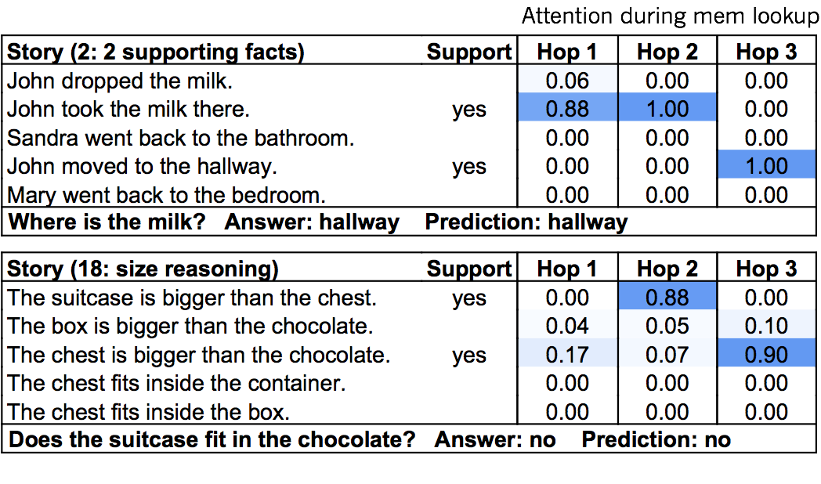
What Tasks are Inside?
QA datasets bAbI tasks MCTest SquAD, NewsQA, MS MARCO
SimpleQuestions WebQuestions, WikiQA
WikiMovies, MTurkWikiMovies MovieDD (Movie-Recommendations)
Sentence Completion QACNN
QADailyMail CBT BookTest
Dialogue Goal-Oriented bAbI Dialog tasks Camrest Dialog-based Language Learning MovieDD (QA,Recs dialogue) CommAI-env
Dialogue Chit-Chat Ubuntu multiple-choice UbuntuGeneration Movies SubReddit Reddit
Twitter
VQA/Visual Dialogue TBD..
Add your own dataset! Open source…

Slide 66
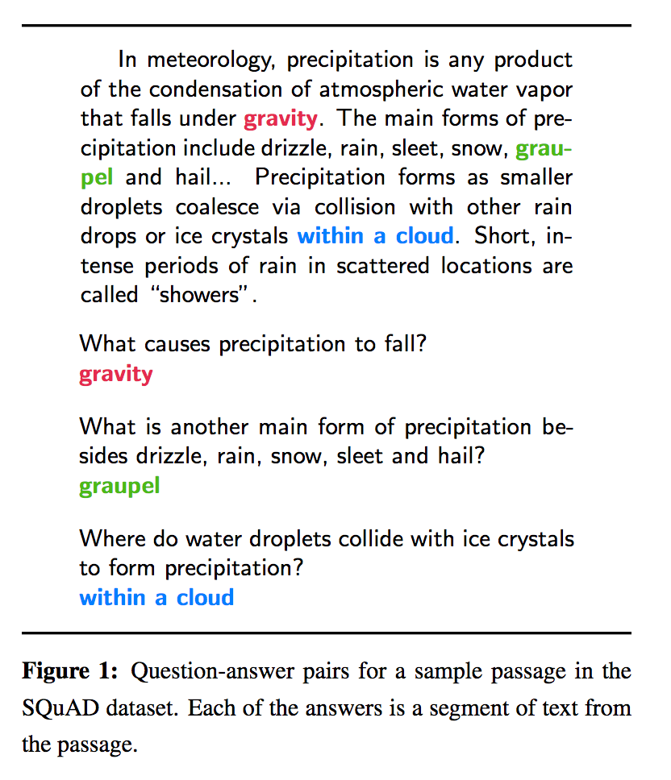
What Tasks are Inside?
QA datasets bAbI tasks MCTest SquAD, NewsQA, MS MARCO
SimpleQuestions WebQuestions, WikiQA
WikiMovies, MTurkWikiMovies MovieDD (Movie-Recommendations)
Sentence Completion QACNN
QADailyMail CBT BookTest
Dialogue Goal-Oriented bAbI Dialog tasks Camrest Dialog-based Language Learning MovieDD (QA,Recs dialogue) CommAI-env
Dialogue Chit-Chat Ubuntu multiple-choice UbuntuGeneration Movies SubReddit Reddit
Twitter
VQA/Visual Dialogue TBD..
Add your own dataset! Open source…

Slide 67
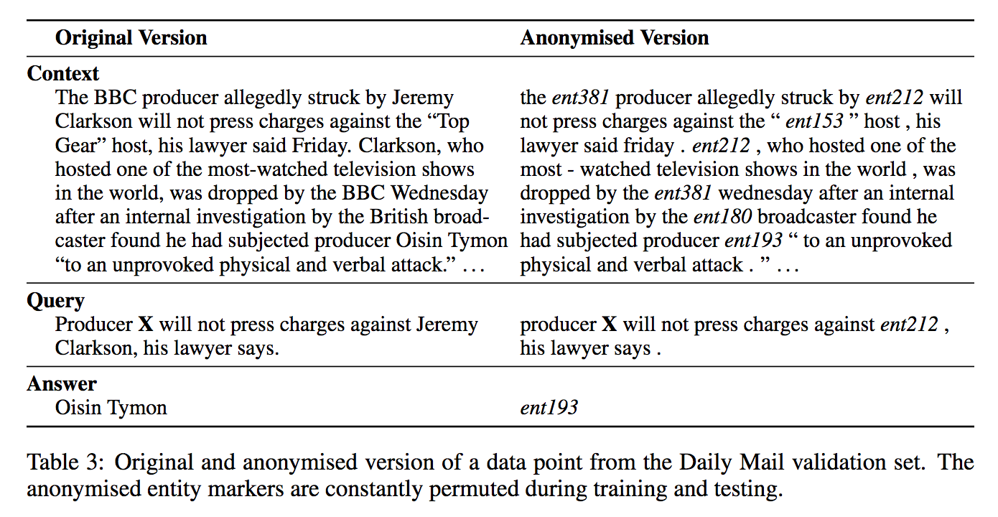
What Tasks are Inside?
QA datasets bAbI tasks MCTest SquAD, NewsQA, MS MARCO
SimpleQuestions WebQuestions, WikiQA
WikiMovies, MTurkWikiMovies MovieDD (Movie-Recommendations)
Sentence Completion QACNN
QADailyMail CBT BookTest
Dialogue Goal-Oriented bAbI Dialog tasks Camrest Dialog-based Language Learning MovieDD (QA,Recs dialogue) CommAI-env
Dialogue Chit-Chat Ubuntu multiple-choice UbuntuGeneration Movies SubReddit Reddit
Twitter
VQA/Visual Dialogue TBD..
Add your own dataset! Open source…

Slide 68
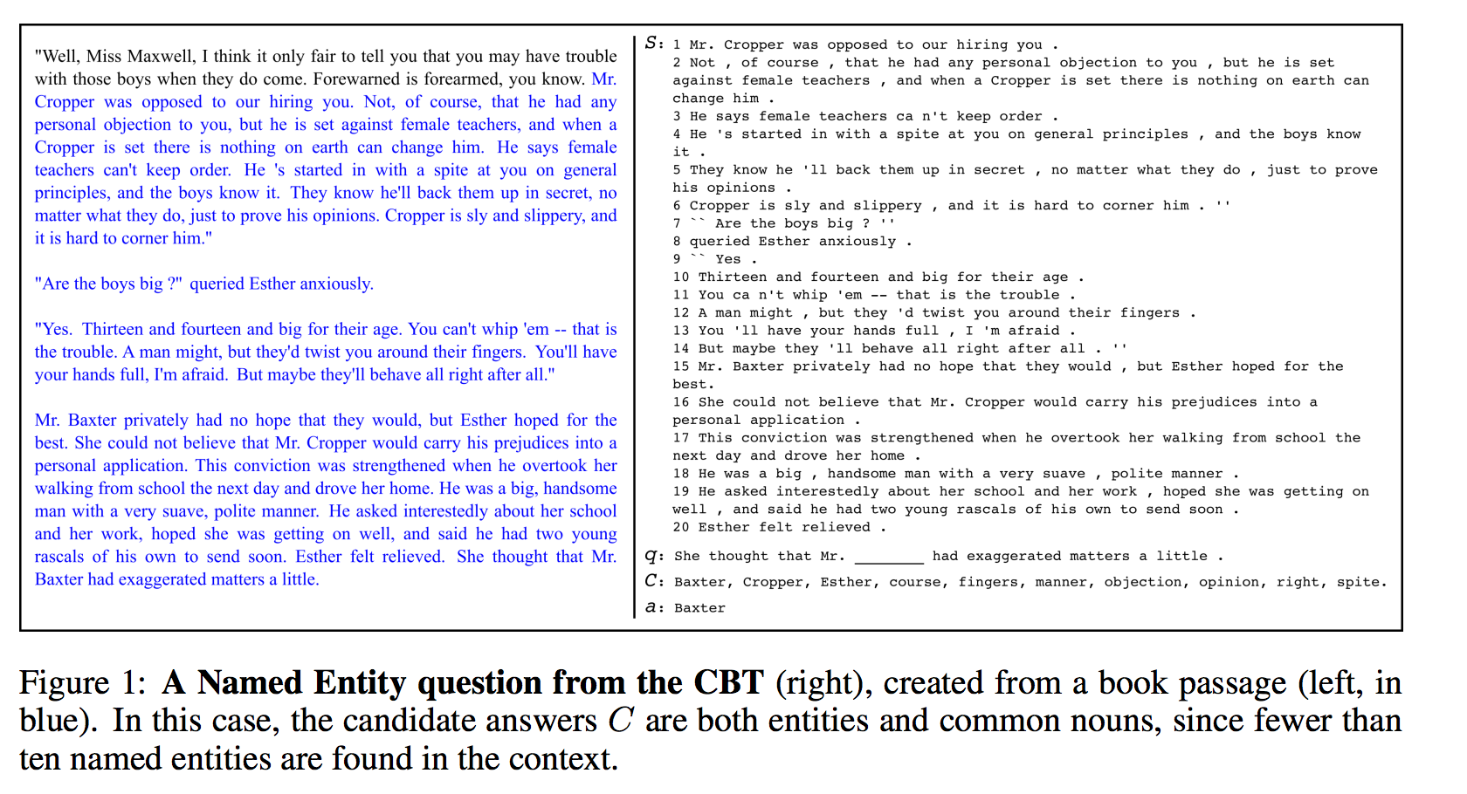
What Tasks are Inside?
QA datasets bAbI tasks MCTest SquAD, NewsQA, MS MARCO
SimpleQuestions WebQuestions, WikiQA
WikiMovies, MTurkWikiMovies MovieDD (Movie-Recommendations)
Sentence Completion QACNN
QADailyMail CBT BookTest
Dialogue Goal-Oriented bAbI Dialog tasks Camrest Dialog-based Language Learning MovieDD (QA,Recs dialogue) CommAI-env
Dialogue Chit-Chat Ubuntu multiple-choice UbuntuGeneration Movies SubReddit Reddit
Twitter
VQA/Visual Dialogue TBD..
Add your own dataset! Open source…

Slide 69
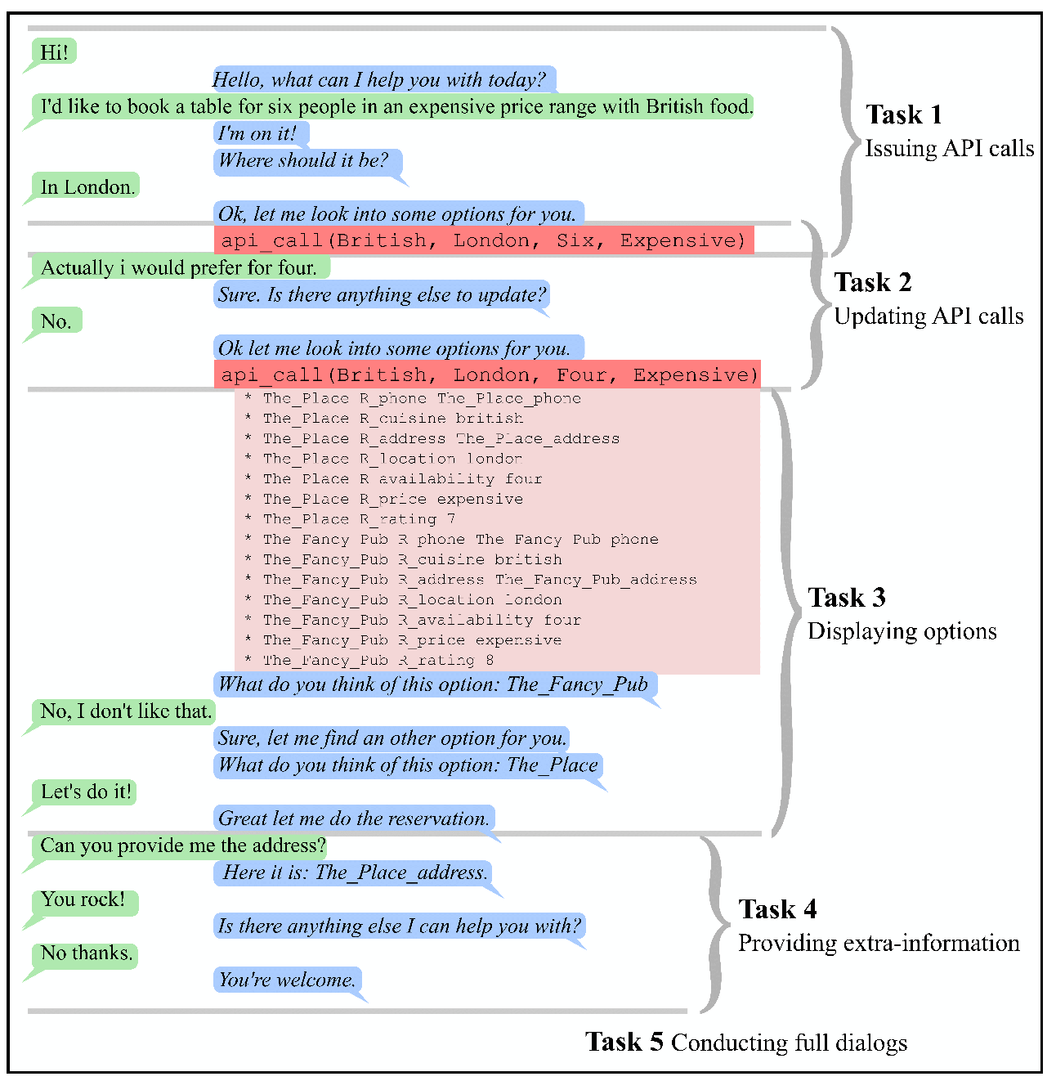
What Tasks are Inside?
QA datasets bAbI tasks MCTest SquAD, NewsQA, MS MARCO
SimpleQuestions WebQuestions, WikiQA
WikiMovies, MTurkWikiMovies MovieDD (Movie-Recommendations)
Sentence Completion QACNN
QADailyMail CBT BookTest
Dialogue Goal-Oriented bAbI Dialog tasks Camrest Dialog-based Language Learning MovieDD (QA,Recs dialogue) CommAI-env
Dialogue Chit-Chat Ubuntu multiple-choice UbuntuGeneration Movies SubReddit Reddit
Twitter
VQA/Visual Dialogue TBD..
Add your own dataset! Open source…

Slide 70
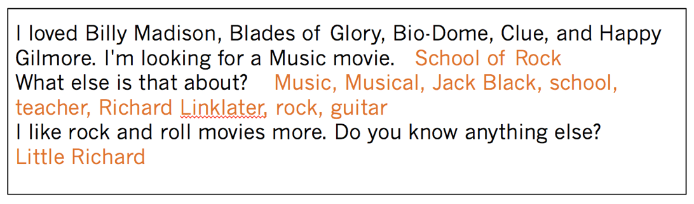
What Tasks are Inside?
QA datasets bAbI tasks MCTest SquAD, NewsQA, MS MARCO
SimpleQuestions WebQuestions, WikiQA
WikiMovies, MTurkWikiMovies MovieDD (Movie-Recommendations)
Sentence Completion QACNN
QADailyMail CBT BookTest
Dialogue Goal-Oriented bAbI Dialog tasks Camrest Dialog-based Language Learning MovieDD (QA,Recs dialogue) CommAI-env
Dialogue Chit-Chat Ubuntu multiple-choice UbuntuGeneration Movies SubReddit Reddit
Twitter
VQA/Visual Dialogue TBD..
Add your own dataset! Open source…

Slide 71
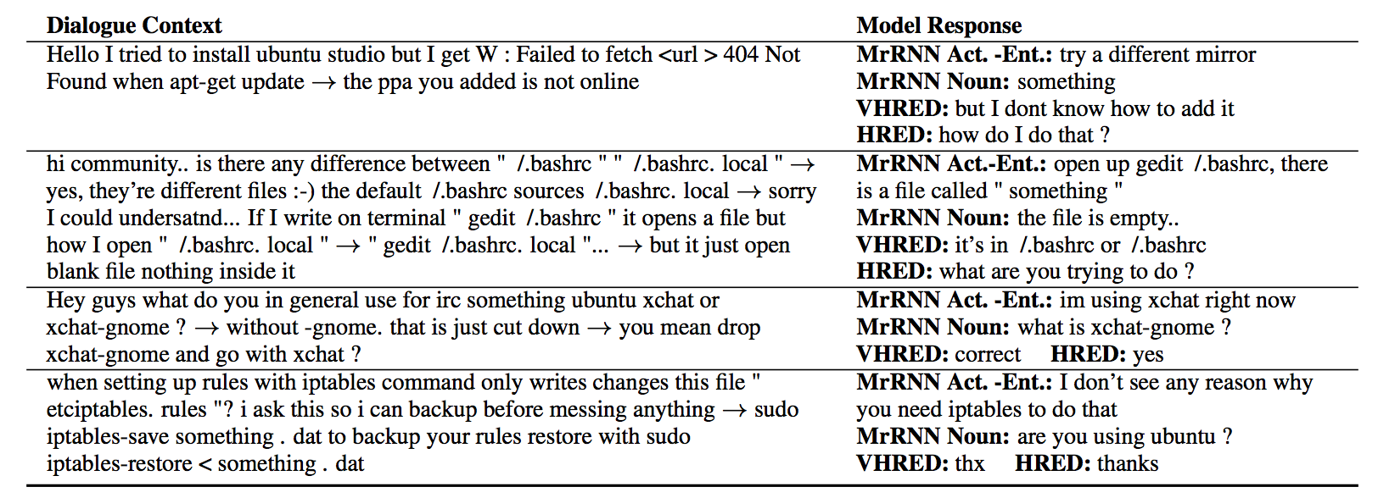
What Tasks are Inside?
QA datasets bAbI tasks MCTest SquAD, NewsQA, MS MARCO
SimpleQuestions WebQuestions, WikiQA
WikiMovies, MTurkWikiMovies MovieDD (Movie-Recommendations)
Sentence Completion QACNN
QADailyMail CBT BookTest
Dialogue Goal-Oriented bAbI Dialog tasks Camrest Dialog-based Language Learning MovieDD (QA,Recs dialogue) CommAI-env
Dialogue Chit-Chat Ubuntu multiple-choice UbuntuGeneration Movies SubReddit Reddit
Twitter
VQA/Visual Dialogue TBD..
Add your own dataset! Open source…

Slide 72
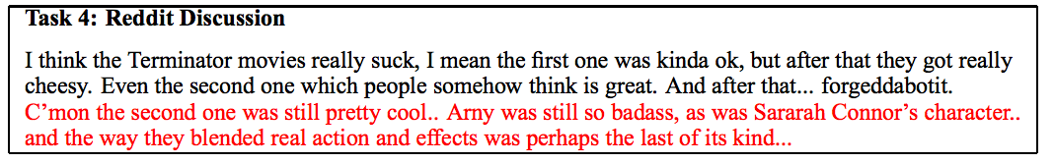
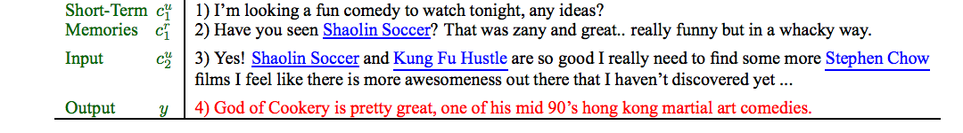
What Tasks are Inside?
QA datasets bAbI tasks MCTest SquAD, NewsQA, MS MARCO
SimpleQuestions WebQuestions, WikiQA
WikiMovies, MTurkWikiMovies MovieDD (Movie-Recommendations)
Sentence Completion QACNN
QADailyMail CBT BookTest
Dialogue Goal-Oriented bAbI Dialog tasks Camrest Dialog-based Language Learning MovieDD (QA,Recs dialogue) CommAI-env
Dialogue Chit-Chat Ubuntu multiple-choice UbuntuGeneration Movies SubReddit Reddit
Twitter
VQA/Visual Dialogue TBD..
Add your own dataset! Open source…

Slide 73
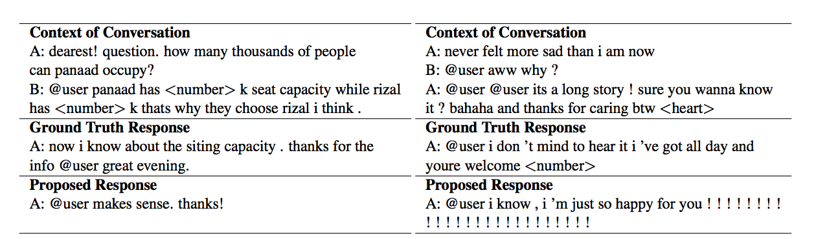
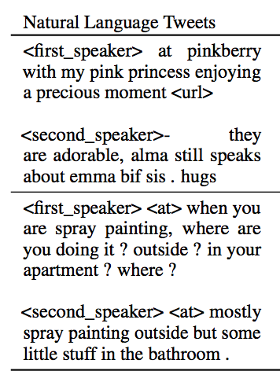
What Tasks are Inside?
QA datasets bAbI tasks MCTest SquAD, NewsQA, MS MARCO
SimpleQuestions WebQuestions, WikiQA
WikiMovies, MTurkWikiMovies MovieDD (Movie-Recommendations)
Sentence Completion QACNN
QADailyMail CBT BookTest
Dialogue Goal-Oriented bAbI Dialog tasks Camrest Dialog-based Language Learning MovieDD (QA,Recs dialogue) CommAI-env
Dialogue Chit-Chat Ubuntu multiple-choice UbuntuGeneration Movies SubReddit Reddit
Twitter
VQA/Visual Dialogue TBD..
Add your own dataset! Open source…

Slide 74

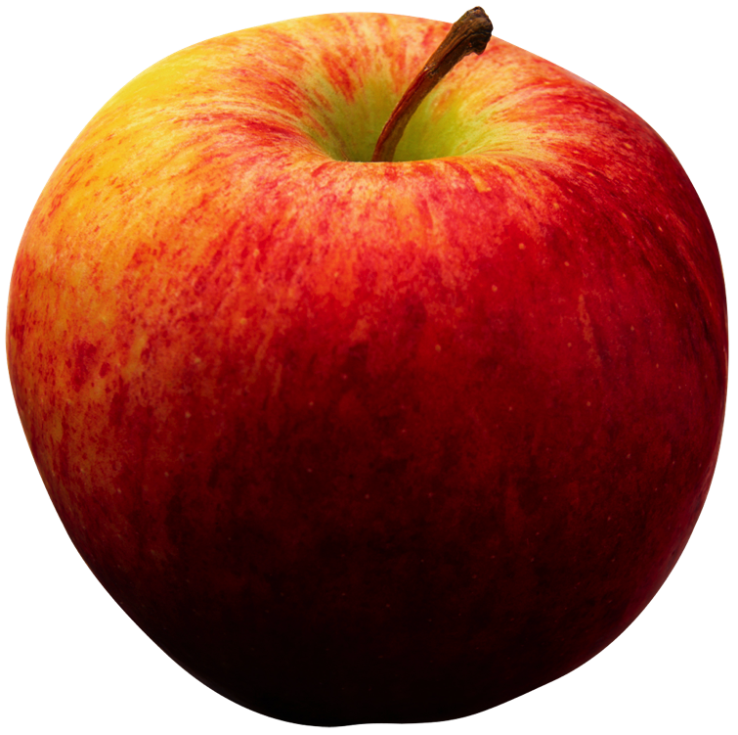

So we still fail on some tasks….
.. and we could also make more tasks that we fail on!
Our hope is that a feedback loop of:
Developing tasks that break models, and
Developing models that can solve tasks
… leads in a fruitful research direction….

Slide 75
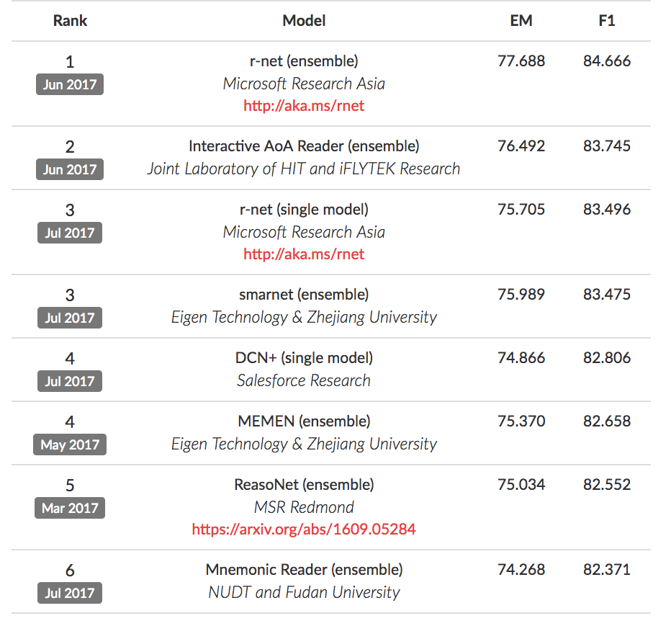
SQuAD dataset

Slide 76

WARNING
Working on individual datasets can lead to siloed research,overfitting to specific qualities of a task that don’t generalize to other tasks.
For example, methods that do not generalize beyond:
WebQuestions (Berant et al., ‘13) because they specialize on knowledge bases only,
SQuAD (Rajpurkar et al, ’16) because they predict start and end context indices; relies on word-overlap
bAbI (Weston et al., ‘15) because they use supporting facts or make use of its simulated nature.
CBT or QACNN aren’t really QA or dialogue tasks (closer to LM)
We want to find models/ideas that work on many tasks!!!!

Slide 77
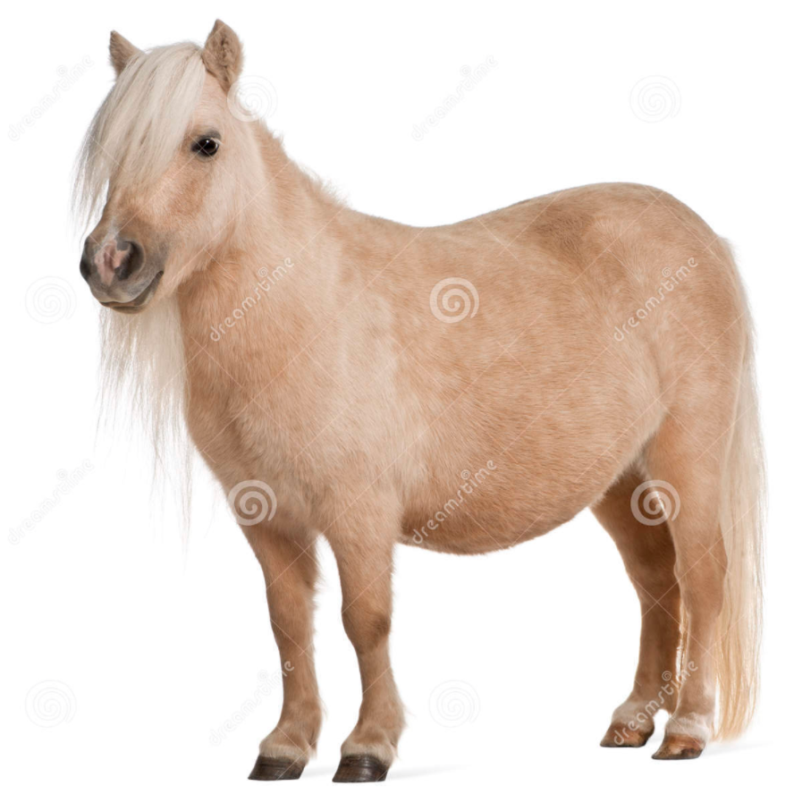
Why Unify?
We want models that aren’t just one-trick
We can find model weaknesses & iterate
We can study task transfer, compositionality,..
Maybe one day we can get close to AI ;)
-> an agent that is good at (all?) dialog

Slide 78
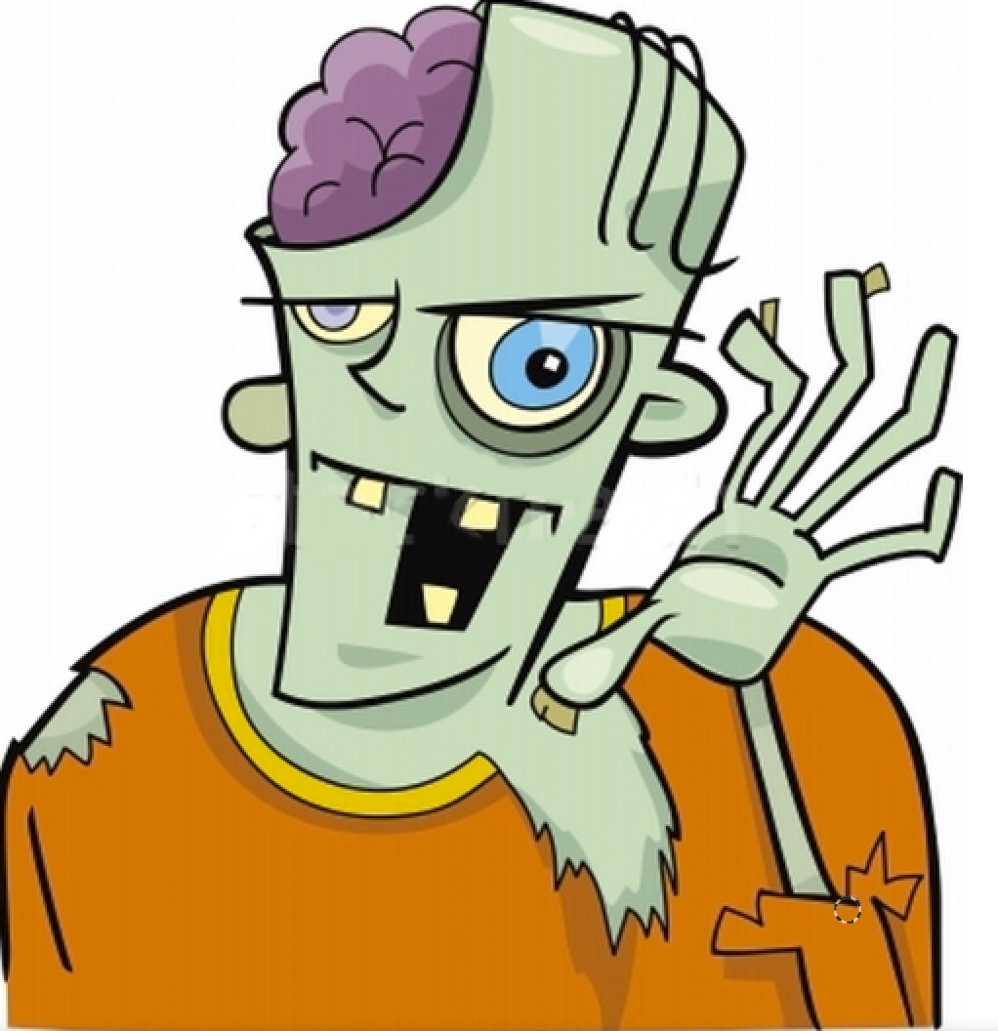
We studied some ingredients to build a dialog agent: be able to track the world state (people, objects, things) learn from language feedback (i.e. the things said to it) learn from asking questions (which questions? when to ask?) have a unified learning system not a bunch of hard-coded hacks - avoid siloed research with less long-term impact - move towards putting these things together - one option: use ParlAI We are offering 7x ~$20k research grants !!! Aug 25 deadline! See the website: http://parl.ai
Conclusion
Thanks!

